Slide 1

Housing Prices Analysis
Presented for: Investment Bank
Presented by: Joyce H. Chan

Slide 2
Introduction
Statistical analysis of house prices can confirm or reject assumptions of what factors are significant drivers of house prices
Does a home’s total lot area affect sale price? Does the number of bedrooms in a house influence the price?
Analysis results can help with decisions on where to allocate dollars for investment into mortgage-backed securities
Results can also help with homebuyers’ decisions when looking for a house
Notes:
This topic is personally interesting to me because I love looking at homes and renovations and I am fascinated by the housing market. This analysis is useful to anyone looking into investing in real estate or buying their own homes. It is particularly useful to myself as well because I will be looking into buying a house in the next few years. There are some factors that you might intuitively assume to be major drivers of house price but are they really? For example, does a home’s total lot area affect its sale price? Does the number of bedrooms in a house influence the price? That’s why statistical analysis is important so we can see if factors like that are significant drivers of house price or not.

Slide 3

Business Objective
Determine factors
that drive home prices.
Notes:
The business objective of our presentation today is to simply determine factors that drive home prices.

Slide 4
Hypotheses
Lot Area (square feet)
Garage car capacity
Living area above ground (square feet)
Bedrooms above ground
Bathrooms above ground
Neighborhood
Number of fireplaces
Total rooms above ground
Year Built
Overall quality
Overall condition
I hypothesized that these factors would influence the sale price of a house.
Notes:
I have a few hypotheses that I looked at in this analysis. A broad hypothesis I worked with was that these 11 factors would influence the sale price of a house. (read the factors)

Slide 5
Hypotheses
H₁: There is no significance difference in the mean sale price for houses with overall quality <6 and houses with overall quality ≥6.
H₂: There is no significant difference in the mean sale price for houses built before 1971 and houses built in 1971 or after.
H₃: There is no significant difference in the mean sale price for houses with >7 total rooms, and houses with ≥7 total rooms.
Notes:
What this means in layman terms:
Hypothesis 1: Overall quality is NOT a significant driver of sale price.
Hypothesis 2: Construction date of house is NOT a significant driver of sale price.
Hypothesis 3: Total rooms in a house is NOT a significant driver of sale price.

Slide 6

Data
This dataset comes from Kaggle. It contains various features and attributes of residential homes in Ames, Iowa, USA.
Key details:
Number of Houses: The dataset consists of 1460 house IDs.
Number of Features: There are 81 different features or variables that describe various aspects of the residential properties.
Data Types: The features include both numerical and categorical variables, covering a wide range of aspects such as lot size, number of rooms, location, construction date, and more.

Slide 7
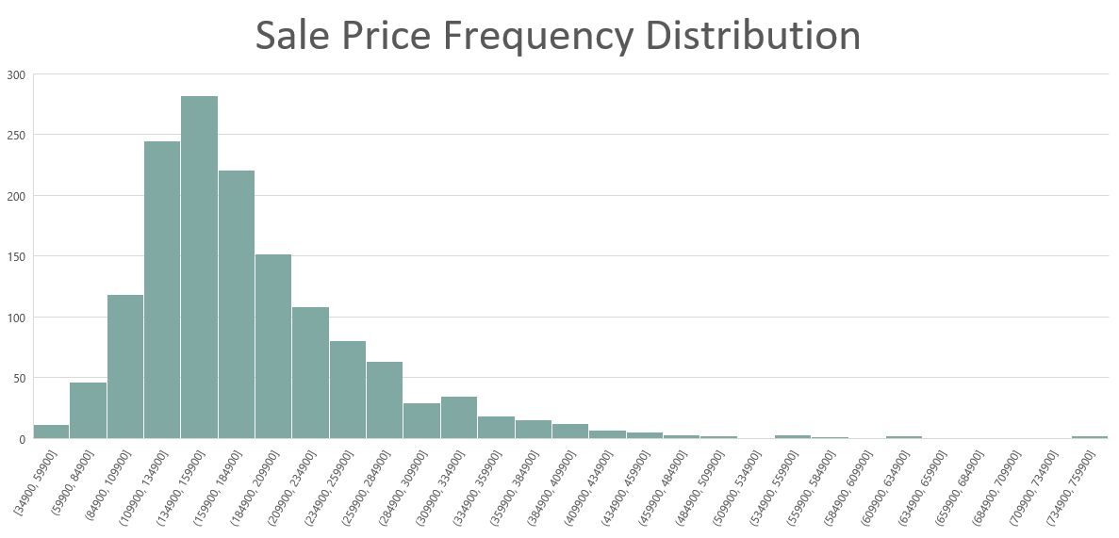
Notes:
This histogram of the sale prices means that the samples we’re working with has normal distribution. It follows a bell curve and most of the observations cluster around the central peak.
(The purpose of the t-test is to compare certain characteristics representing groups and the mean values become representative when the population has a normal distribution.)

Slide 8
Descriptive Statistics
 | Total Rooms | Year Built | Overall Quality | Sale Price
Mean | 6.5 | 1971 | 6 (Above Average) | $180,921
Range | 2 to 14 | 1872-2010 | 1-10 (Very Poor to Very Excellent) | $34,900 to $755,000
Total Homes | 1460
Notes:
These are some descriptive statistics here of the factors we want to look at closely.
There’s a total of 1460 homes in this sample with an average quality of 6, meaning above average. Houses have an average of 6.5 total rooms above ground and range from 2 to 14 rooms. The average house was built in 1971 but build years range from 1872 to 2010. The mean sale price is $180,921.

Slide 9
Methods
Excel Data Analysis Toolpak
Descriptive Statistics
Correlations between variables and sale price
Hypothesis Testing – two-sample assuming unequal variances
Confidence Interval Calculation
Visualizations – charts, tables
Notes:
The methods I used for this analysis include: the Excel Data Analysis Toolpak which I used to find the descriptive statistics and correlations between the different variables and sale price. I used Excel to conduct two-sample t-tests assuming unequal variances. I also did confidence interval calculations and made visualizations in excel of my results.

Slide 10
Analysis Results
Below are the factors from my hypothesis along with their level of impact on the sale price, sorted by correlation.
Type of Correlation | Factor | Correlation
High Impact | Overall Quality | 0.790981601
 | Above Ground Living Area | 0.708624478
 | Garage Cars | 0.640409197
 | Total Baths | 0.631731068
 | Total Rooms Above Ground | 0.533723156
 | Year Built | 0.522897333
 | Fireplaces | 0.466928837
Low Impact | Lot Area | 0.263843354
 | Bedrooms Above Ground | 0.168213154
No impact | Overall Condition | -0.077855894
Notes:
Recall that I had 11 factors that I hypothesized to be factors that drive house prices. These are the correlations of each variable compared to the sale price that I found through excel, ranked from highest correlation to lowest correlation.
The factors that have a high correlation with sale price are: overall quality, above ground living area, garage car capacity, total bathrooms, total rooms above ground, year built and number of fireplaces.
Lot area, bedrooms above ground have a very minimal impact on the sale price, and overall condition of the house was found to have NO impact at all on sale price.
Note that the neighborhood factor is a categorical variable so correlation could not be tested but we will take a look at it on the next slide.

Slide 11
Analysis Results
Top 3 Neighborhoods:
Northridge
Northridge Heights
Stone Brook
Homes in the Northridge neighborhood have the highest sale price on average.
Notes:
The top 3 neighborhoods with the highest mean house price are Northridge, Northridge Heights, and Stone Brook.

Slide 12
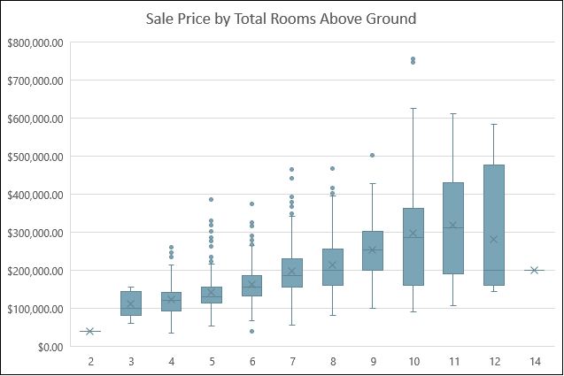
Total Rooms Above Ground
Analysis results: reject null hypothesis
Correlation: 0.534
T-tests:
Ho: μ1 - μ2 = 0 Ha: μ1 - μ2 ≠ 0
Separated by two groups: Total rooms <7 and Total rooms ≥7
P-value: 1.0968E-63 (<0.05)
Confidence interval: At the 95% confidence level, the difference of means (70,849) is between 63,174 and 78,523.
Notes:
The first specific hypotheses that we take a look at is whether total rooms above ground has an influence on sale price. The null hypothesis is that it does not. I separated the sample into 2 groups: houses with less than 7 total rooms and houses with 7 or more total rooms. I compared the means of these 2 groups with a two-tailed t-test and the resulting p-value was much less than 0.05, meaning there is a significant difference between the 2 means at a 95% confidence level.
Through my analysis, we can REJECT the null hypothesis. In simple terms, the more rooms the house has above ground, the higher the mean sale price. Total rooms above ground is a significant driver of house sale price.

Slide 13
Year Built
Analysis results: reject null hypothesis
Correlation: 0.523
T-tests:
Ho: μ1 - μ2 = 0 Ha: μ1 - μ2 ≠ 0
Separated by two groups: Year Built <1971 and Year Built ≥1971
P-value: 1.19022E-89 (<0.05)
Confidence interval: At the 95% confidence level, the difference of means (77,008) is between 70,081 and 83,936.
Notes:
My 2nd null hypothesis is that a home’s build year has no influence on the sale price. I separated the sample into 2 groups: homes built before 1971 and homes built in 1971 or after. I compared the means of these 2 groups with a two-tailed t-test and the resulting p-value was much less than 0.05, meaning there is a significant difference between the 2 means at a 95% confidence level.
Through my analysis, we can again reject the null hypothesis. The newer the construction date of the house, the higher the mean sale price. The build year is a significant driver of sale price.

Slide 14
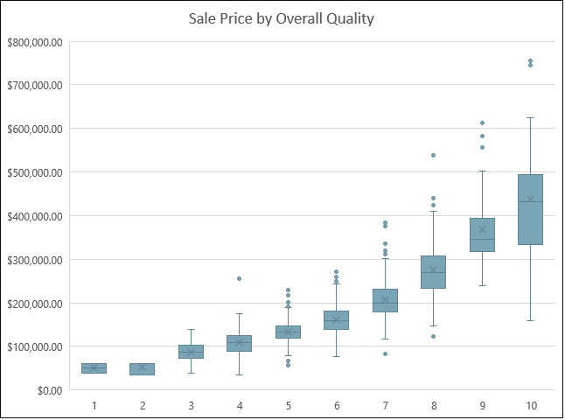
Overall Quality
Analysis results: reject null hypothesis
Correlation: 0.79
T-tests:
Ho: μ1 - μ2 = 0 Ha: μ1 - μ2 ≠ 0
Separated by two groups: Overall quality <6 and overall quality ≥6
P-value: 5.9183E-145 (<0.05)
Confidence interval: At the 95% confidence level, the difference of means (87,549) is between 81,678 and 93,420.
Notes:
My 3rd null hypothesis is that a home’s overall quality has no influence on the sale price. Recall that the mean overall quality of all houses in this dataset is 6 which equates to ‘above average’. I separated the sample into 2 groups: homes with overall quality less than 6, and homes with overall quality of 6 or higher.
I compared the means of these 2 groups with a two-tailed t-test and the resulting p-value was much less than 0.05, meaning there is a significant difference between the 2 means at a 95% confidence level.
Through my analysis, we can again reject the null hypothesis. The higher quality of the house, the higher the mean sale price. The overall quality of a house is a significant driver of sale price.

Slide 15
Recommendations
Focus on the following factors when investing in mortgage-backed securities:
Overall Quality
Above Ground Living Area
Garage Car Capacity
Total Baths
Total Rooms Above Ground
Year Built
Number of Fireplaces
Neighborhood
Notes:
In summary, my recommendation is to focus on these 8 factors when investing in mortgage-backed securities.
Overall quality, above ground living area, garage car capacity, total baths, total rooms, year built, number of fireplaces, and neighborhood. These are factors that drive housing prices with a positive correlation.

Slide 16
Recommendations
Lot area and number of bedrooms have minimal impact on sale price
Overall condition has NO effect on sale price
Practical recommendations:
For investors:
Invest in newer-built homes in the Northridge neighborhood with a large garage and at least 1 fireplace
Prioritize homes with more rooms and larger living areas rather than homes with a large lot area
Prioritize homes with many bathrooms rather than many bedrooms
Focus on excellent quality homes rather than homes in good condition
For homebuyers on a budget:
Even if you don’t have a high budget when home shopping, you may still find an affordable home with a relatively large lot area and in excellent condition since sale price isn’t significantly driven by these factors

Slide 17

QUESTIONS?

